Slide 1
Evaluating a Machine Learning Model
Owais A. Hussain

Slide 2
Outlines
Recap
Confusion Matrix
High Accuracy Trap
Choosing the Right Metric
A Balanced Metric
High Accuracy Trap
Inventing your own Metrics
ROC and AUC
There are many more…

Slide 3
Recap
Machine learning model evaluation
Hold-out method
Cross-validation method
Sampling methods:
Random
Stratified
Bootstrap
Why evaluate?

Slide 4
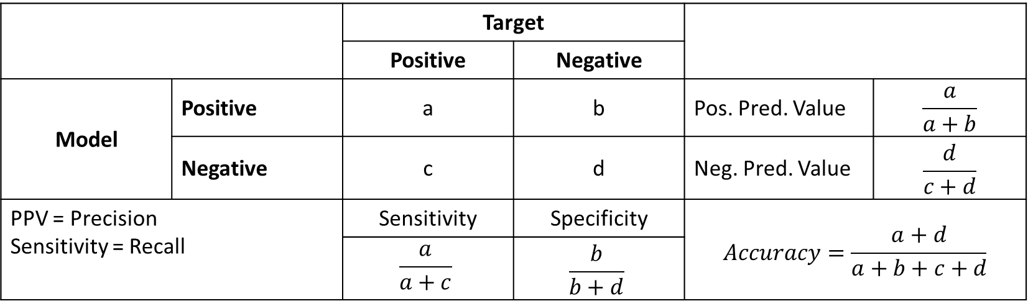
Confusion Matrix
NxN (distinct classes) matrix to show the number of correct and incorrect classifications.
For binary classifications, it looks like this:
 |  | Target
 |  | Positive | Negative
Model | Positive | a | b | Pos. Pred. Value | $$\frac{a}{a+b}$$
 | Negative | c | d | Neg. Pred. Value | $$\frac{d}{c+d}$$
PPV = Precision Sensitivity = Recall |  | Sensitivity | Specificity | $$Accuracy=\frac{a+d}{a+b+c+d}$$
 |  | $$\frac{a}{a+c}$$ | $$\frac{b}{b+d}$$

Slide 5
High Accuracy Trap
Case 1: An automobile manufacturer wants to classify people interested in buying a luxury car to market their latest flagship car.
Case 2: Health ministry wants to classify high-risk potentially cancerous people for a new preventive therapy with serious side effects.
Case 3: An academic grant is interested in awarding scholarships to study abroad, only to candidates who would potentially return after completion.
Which one is the right metric for these cases?

Slide 6
Choosing the Right Metric
Model ‘A’
Accuracy: 0.70
Model ‘B’
Accuracy: 0.70
 | Positive | Negative
Positive | 45 | 5
Negative | 25 | 25
 | Positive | Negative
Positive | 25 | 25
Negative | 5 | 45
Notes:
Are these two models same?

Slide 7
Sensitivity (Recall)
Model ‘A’
Accuracy: 0.70
Sensitivity: 0.64
Model ‘B’
Accuracy: 0.70
Sensitivity: 0.83
 | Positive | Negative
Positive | 45 | 5
Negative | 25 | 25
 | Positive | Negative
Positive | 25 | 25
Negative | 5 | 45
Notes:
How many positives, out of all actual positives were retrieved?
A radar should have high Recall, even if sometimes it alerts on birds.

Slide 8
Precision (Positive Prediction Value)
Model ‘A’
Accuracy: 0.70
Sensitivity: 0.64
Precision: 0.90
Model ‘B’
Accuracy: 0.70
Sensitivity: 0.83
Precision : 0.50
 | Positive | Negative
Positive | 45 | 5
Negative | 25 | 25
 | Positive | Negative
Positive | 25 | 25
Negative | 5 | 45
Notes:
The model does not call it positive until it is very confident.
The high-risk cancer procedure should have high precision, even if it means it will reject some of the actual cancer patients.

Slide 9
Specificity
Model ‘A’
Accuracy: 0.70
Sensitivity: 0.64
Precision : 0.90
Specificity: 0.83
Model ‘B’
Accuracy: 0.70
Sensitivity: 0.83
Precision : 0.50
Specificity: 0.64
 | Positive | Negative
Positive | 45 | 5
Negative | 25 | 25
 | Positive | Negative
Positive | 25 | 25
Negative | 5 | 45
Notes:
The model is able to retrieve as many negatives as possible.
The HEC should have a high specificity model for grants. Even if some deserving candidates are incorrectly rejected the grant, thinking they will not return.

Slide 10
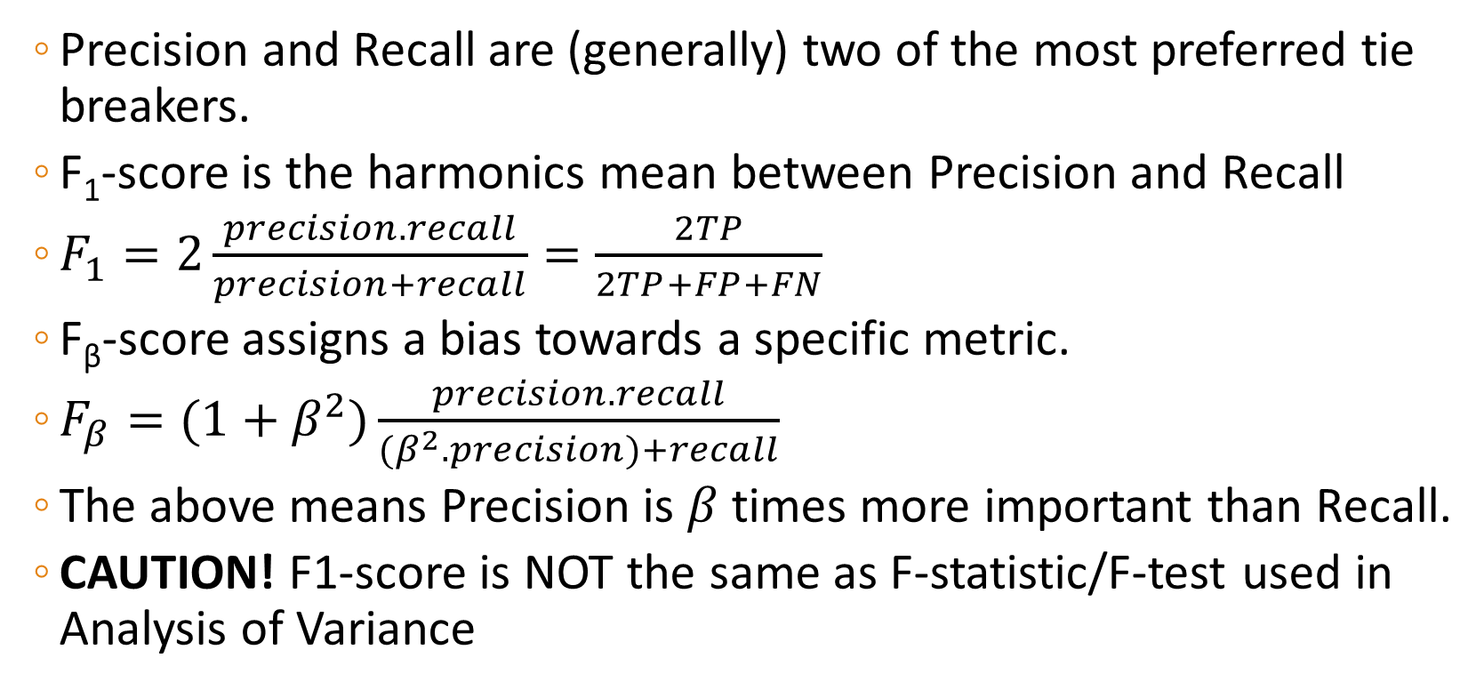
Is there a way to balance them all?
Precision and Recall are (generally) two of the most preferred tie breakers.
F₁-score is the harmonics mean between Precision and Recall
$F_{1}=2\frac{precision.recall}{precision+recall}=\frac{2TP}{2TP+FP+FN}$
F_{β}-score assigns a bias towards a specific metric.
$F_{β}=(1+β^{2})\frac{precision.recall}{(β^{2}.precision)+recall}$
The above means Precision is $β$ times more important than Recall.
CAUTION! F1-score is NOT the same as F-statistic/F-test used in Analysis of Variance

Slide 11
F₁-Score
Model ‘A’
Accuracy: 0.70
Sensitivity: 0.64
Precision : 0.90
Specificity: 0.83
F₁-Score: 0.75
Model ‘B’
Accuracy: 0.70
Sensitivity: 0.83
Precision : 0.50
Specificity: 0.64
F₁-Score: 0.63
 | Positive | Negative
Positive | 45 | 5
Negative | 25 | 25
 | Positive | Negative
Positive | 25 | 25
Negative | 5 | 45
Notes:
The model is able to retrieve as many negatives as possible.
The HEC should have a high specificity model for grants. Even if some deserving candidates are incorrectly rejected the grant, thinking they will not return.

Slide 12
Very High Accuracy Trap
My model is already 99% accurate. I shouldn’t need all these.
Case 4: Airport Security requires a model, which can detect arms in luggage.
The problem? In real world, there’s no weapon in passenger luggage in 999/1000 cases.

Slide 13
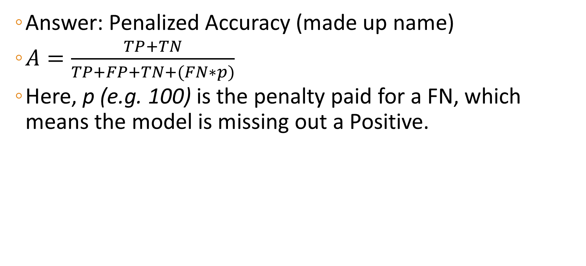
Inventing your own Metrics
Answer: Penalized Accuracy (made up name)
$A=\frac{TP+TN}{TP+FP+TN+(FN∗p)}$
Here, p (e.g. 100) is the penalty paid for a FN, which means the model is missing out a Positive.

Slide 14
ROC-AUC
Receiver Operating Characteristic Curve is a graphical plot.
Used to evaluate the performance of model on different probability thresholds for classification.
Probability is the threshold on which we label a case as Positive.
The curve is plot by setting various values for probability and computing FPR (x-axis) and TPR (y-axis).
Probability threshold itself is not shown on graph
AUC is the Area Under the ROC Curve

Slide 15
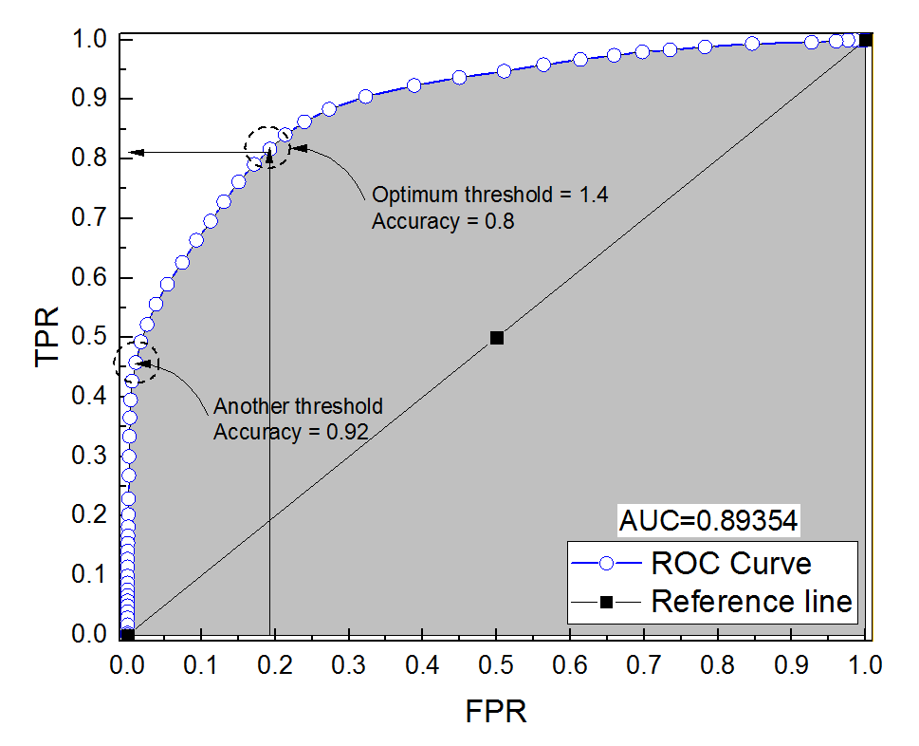
ROC-AUC
https://i.stack.imgur.com/kxfbR.png

Slide 16
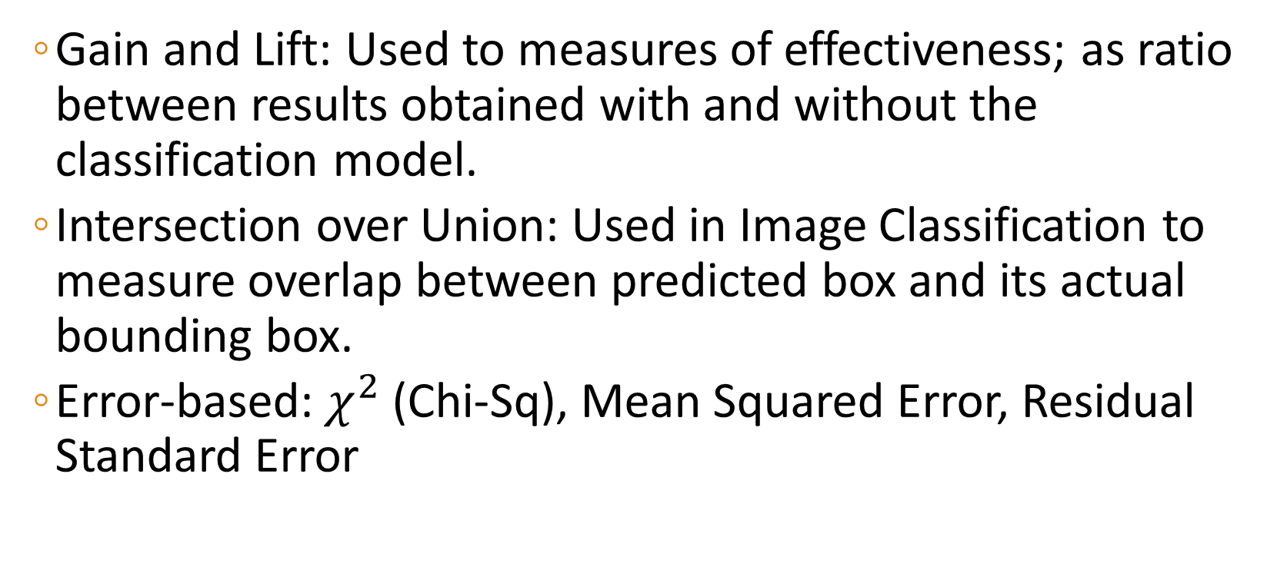
There are many more…
Gain and Lift: Used to measures of effectiveness; as ratio between results obtained with and without the classification model.
Intersection over Union: Used in Image Classification to measure overlap between predicted box and its actual bounding box.
Error-based: $χ^{2}$ (Chi-Sq), Mean Squared Error, Residual Standard Error

Slide 17
?

Slide 18
Thank you…

